Slide 1
urBooks
November 4th, 2014
Reid Stancu
Nam Thach

Slide 2
Description
Android application to Buy/Sell/Trade books
User creatable lists for buy/sell/trade
App notifies user of potential buy/sell/trade candidates
Able to use image recognition to add books
Take photo with Phone camera → book added to user account
Able to search for books

Slide 3
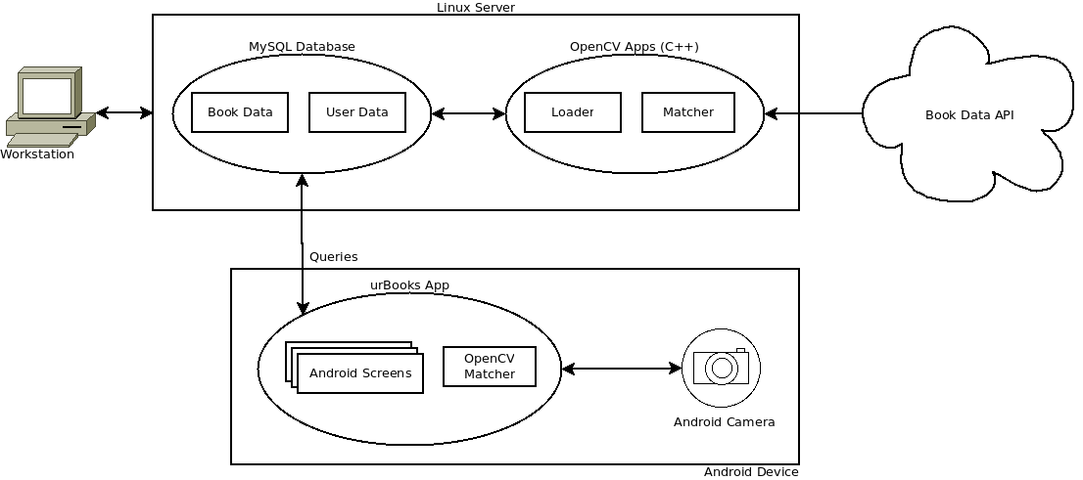
System Overview

Slide 4
Server Side
Ubuntu Server 14.04 LTS
Linux Apache MySQL PHP (LAMP) to serve the Android app
phpMyAdmin for convenience
OpenCV for image processing (possibly ZBar for barcode scanning)
OpenLibrary Database
Import bulk JSON data (Title, Author, Year, ISBN, Cover.jpg, etc.) to our database using Python.
Host our own copies of Book Cover JPEGs
Use OpenLibrary API as a backup

Slide 5
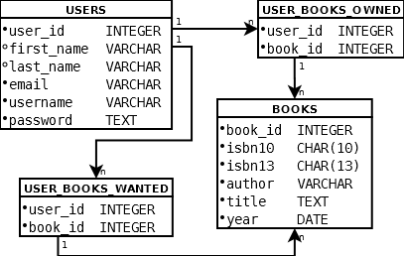
Database
password field is salted + hashed for security

Slide 6
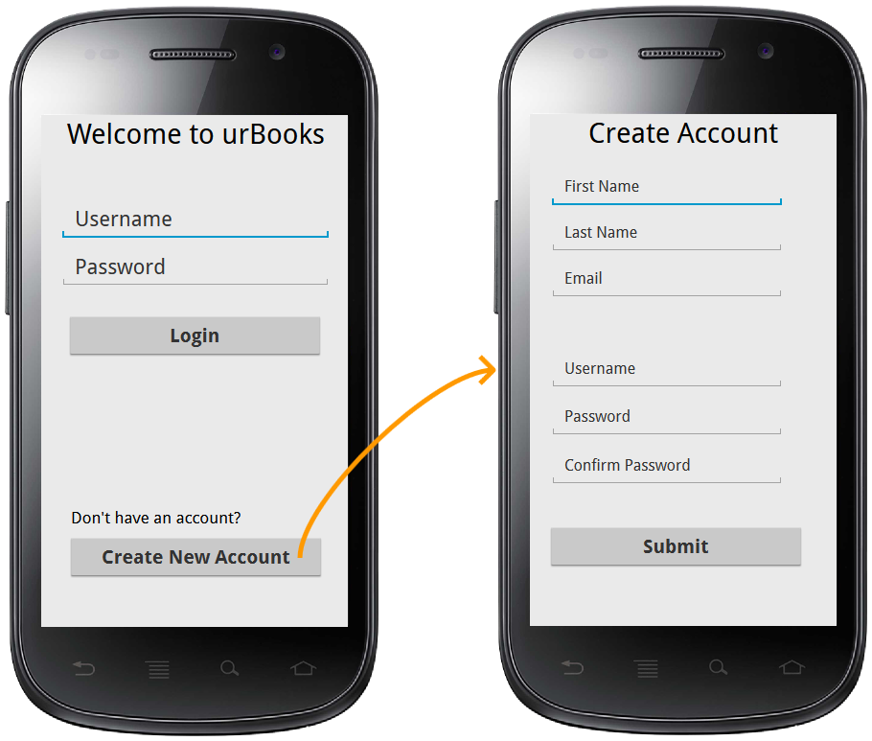
Android Client

Slide 7
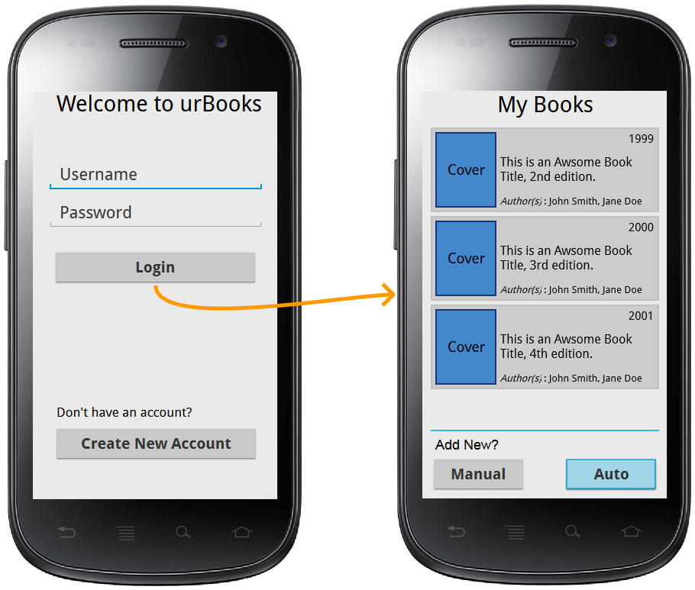
Android Client

